Slide 1
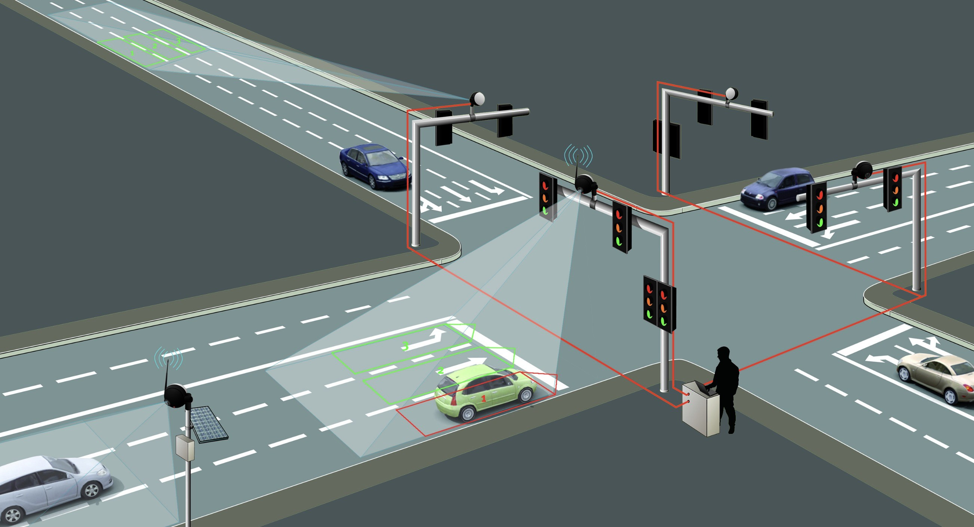
Smart Automatic 4-way Density Based Traffic Control System Using FPGA
Presented By-
Project Group- 03
Group Members-
1906134- Mahema Farzana
1906144- Monideepa Kundu (Sinthi)
1906146- Aliva Sadnim Mahmud
1906151- Samia Akter

Slide 2
Overview:
Objective of the project
Workplan
Design and construction of the project
Relative costing
Social Impacts
References

Slide 3
Objective:
To manage the traffic movement of four intersecting roads
To control the traffic light system based on the density and priority of the lanes
To eliminate conflicts among multiple traffic streams at the intersection
To change the timing and priority sequence based on requirements
To administrate the traffic at the intersections more smartly and interactively with the help of IR sensors

Slide 4
Work Plan:
Assembling components
Constructing the hardware part
Creating the Verilog code on Quartus
Uploading the code in the FPGA
Observing the outcome with several attempts

Slide 5
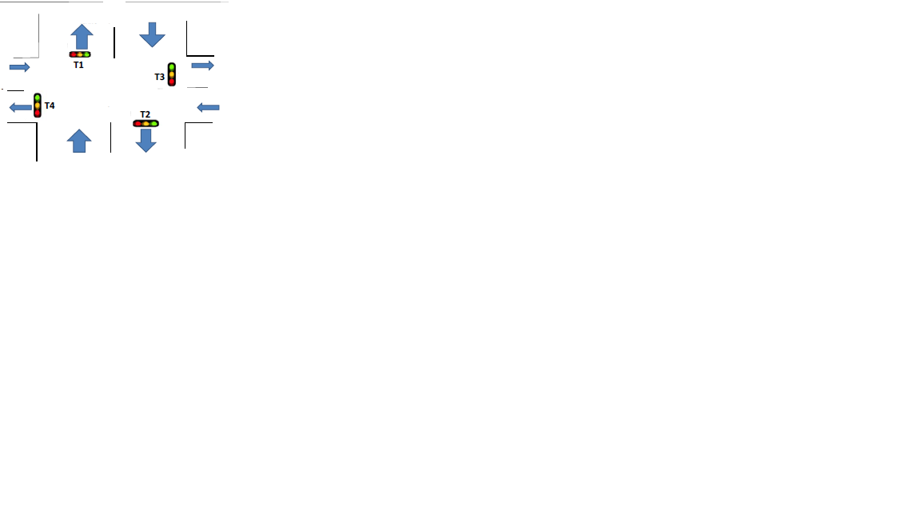
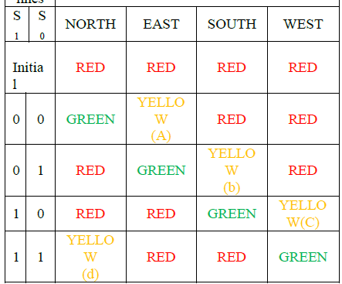
Design and construction of the project:
The structure of the intersection of roads to be controlled.
The tabular column for the working sequence of the project. These states can be controlled manually by switching states and using reset button when necessary

Slide 6
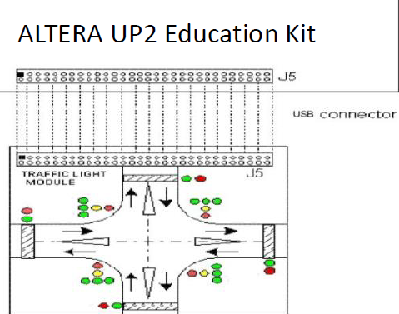
Design and construction of the project:
Components:
ALTERA UP2 Education Kit
IR Sensors
LEDs
Moore type Finite State Machine (FSM)
Resistances
Jumper wires
Power Supply
Breadboard
Circuit connection to the FPGA Board

Slide 7
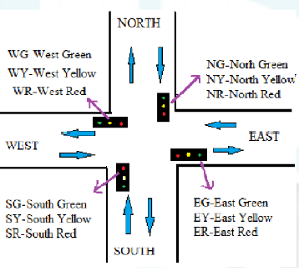
Design and construction of the project:
In this project, we will try to achieve different waiting times depending on the assumption that some lanes get lesser traffic than others. System will be initialized by North Green with the others being Red. With the help of the IR sensors the state can be change by the following steps:
With no density dominance
Density difference
We will implement the algorithm in Verilog.

Slide 8
Design and construction of the project:
Start
Red signal on in 4 directions
Flowchart of constructing the Verilog code
ON
Reset
OFF
S0
S1
S2
S3
North-G
East-Y
South-R
West-R
East-G
South-Y
West-R
North-R
South-G
West-Y
North-R
East-R
West-G
North-Y
South-R
East-R
G- Green
Y- Yellow
R- Red

Slide 9
Costing:
Equipment | Quantity | Cost
Altera UP2 Education kit | 01 | 200
IR sensor | 08 | 250
LEDs | 08 | 50
Resistance | 05 | 100
Breadboard | 01 | 50
Jumper wires | 50 | 100
 | Total | 800

Slide 10
Social Impact:
Significantly reduces noise pollution by reducing traffic congestion and promotes smoother vehicle flow.
Lessens energy consumption
Reduces air pollution
Traffic system will be more organized and smoother
People don’t have to wait for long in the traffic signal
Cheap and easy to implement

Slide 11
References:
https://www.ijraset.com/research-paper/advanced-traffic-light-controller-system-using-fpga-implementation
https://www.researchgate.net/publication/261039428_Design_of_FPGA-based_Traffic_Light_Controller_System
https://www.academia.edu/35014910/Design_of_FPGA_Based_Traffic_Light_Controller_System

Slide 12
Thank You

